Slide 1
Introdução aos Sistemas Embarcados Matriz Inversa - LU
Gerson Zarpelão Jr
Rafael L. Klaser

Slide 2
Matrizes
PC
Testes até 40x40 - capacidade maior
Iterações – 2000 (debug)
Tempo médio: 1.96s /Clock: 2Ghz
FPGA
Limite 20x20 – travou com 25x25
Iterações – 20
Tempo médio: 4.54s /Clock: 66Mhz

Slide 3
Resultado - PC
Matriz A
-37.00 | 6.00 | -20.00 | -45.00 | -36.00 | -42.00 | -35.00 | 44.00 | 19.00 | 28.00 | 1.00 | -36.00 | -34.00 | 48.00 | 19.00 | 31.00 | 16.00 | 31.00 | -15.00 | 9.00
38.00 | -46.00 | -2.00 | -48.00 | -4.00 | 49.00 | 8.00 | -17.00 | 37.00 | -35.00 | -18.00 | 33.00 | -8.00 | -48.00 | 33.00 | -7.00 | 8.00 | 23.00 | 19.00 | 31.00
8.00 | -36.00 | -36.00 | 3.00 | 15.00 | 19.00 | 5.00 | 48.00 | -13.00 | 39.00 | -17.00 | 44.00 | -7.00 | -43.00 | -30.00 | -38.00 | -40.00 | 0.00 | -23.00 | 12.00
-35.00 | 1.00 | 7.00 | -34.00 | -49.00 | -19.00 | 42.00 | -30.00 | -42.00 | 36.00 | -42.00 | -6.00 | -50.00 | 21.00 | -50.00 | -25.00 | 12.00 | 11.00 | 35.00 | 47.00
-24.00 | 30.00 | 21.00 | 34.00 | -19.00 | 47.00 | 23.00 | 20.00 | -27.00 | 12.00 | -40.00 | -46.00 | 10.00 | 43.00 | 31.00 | 41.00 | -37.00 | -16.00 | -5.00 | -5.00
15.00 | 17.00 | -9.00 | 29.00 | -25.00 | -6.00 | -47.00 | 9.00 | 31.00 | -7.00 | 28.00 | -7.00 | -18.00 | -37.00 | -28.00 | -13.00 | 45.00 | 4.00 | -19.00 | 46.00
-43.00 | 0.00 | -2.00 | 21.00 | 0.00 | 7.00 | 7.00 | -37.00 | 38.00 | 25.00 | -15.00 | -30.00 | -45.00 | 37.00 | -11.00 | 16.00 | 0.00 | -13.00 | -45.00 | -37.00
-50.00 | -43.00 | 32.00 | 32.00 | -42.00 | 43.00 | -45.00 | 7.00 | 24.00 | -3.00 | 28.00 | 12.00 | -7.00 | -11.00 | 38.00 | 21.00 | -6.00 | -40.00 | -22.00 | -14.00
2.00 | 14.00 | 19.00 | 5.00 | -50.00 | -39.00 | -16.00 | 19.00 | -3.00 | 49.00 | 44.00 | -37.00 | -18.00 | -15.00 | -8.00 | 26.00 | -24.00 | -22.00 | 30.00 | 34.00
-7.00 | 18.00 | 45.00 | 7.00 | -24.00 | 46.00 | 9.00 | 30.00 | -39.00 | -33.00 | 20.00 | 48.00 | -28.00 | 28.00 | -19.00 | 34.00 | 16.00 | 44.00 | -32.00 | 15.00
-11.00 | -36.00 | -50.00 | 35.00 | -22.00 | -48.00 | 11.00 | -47.00 | -40.00 | -13.00 | 5.00 | 4.00 | 1.00 | 18.00 | 39.00 | -3.00 | 24.00 | 44.00 | -50.00 | -44.00
-31.00 | 11.00 | 2.00 | 31.00 | 15.00 | 22.00 | 36.00 | 31.00 | 33.00 | -1.00 | -34.00 | -2.00 | 22.00 | -41.00 | -45.00 | -31.00 | -40.00 | 20.00 | -11.00 | 39.00
-46.00 | -42.00 | 33.00 | -15.00 | 32.00 | 6.00 | -22.00 | 35.00 | 7.00 | -38.00 | -23.00 | -29.00 | -10.00 | 37.00 | 19.00 | 41.00 | 21.00 | -42.00 | -46.00 | 27.00
-16.00 | -38.00 | -43.00 | -22.00 | -10.00 | 35.00 | 47.00 | -12.00 | -18.00 | 46.00 | -13.00 | -5.00 | -43.00 | -8.00 | -23.00 | -19.00 | 38.00 | -23.00 | -41.00 | -10.00
-50.00 | -43.00 | 18.00 | -17.00 | 32.00 | -24.00 | -37.00 | -7.00 | -4.00 | -32.00 | 26.00 | 26.00 | -6.00 | -8.00 | -47.00 | 45.00 | 46.00 | -1.00 | -40.00 | -20.00
-27.00 | -27.00 | -40.00 | -24.00 | -45.00 | -39.00 | -23.00 | -7.00 | 10.00 | -44.00 | 9.00 | 40.00 | 29.00 | -11.00 | -50.00 | 29.00 | 38.00 | -47.00 | 23.00 | -50.00
33.00 | 33.00 | 13.00 | -41.00 | -13.00 | 41.00 | -37.00 | 41.00 | -42.00 | 0.00 | 40.00 | -36.00 | -39.00 | 6.00 | -8.00 | -8.00 | 14.00 | 44.00 | -46.00 | -49.00
-26.00 | -46.00 | 12.00 | -45.00 | 8.00 | -7.00 | -12.00 | 43.00 | 26.00 | -16.00 | 9.00 | -2.00 | 48.00 | 32.00 | -43.00 | -40.00 | -9.00 | -17.00 | -50.00 | -12.00
-19.00 | -39.00 | 46.00 | -38.00 | 46.00 | 4.00 | -36.00 | -2.00 | -5.00 | -6.00 | 39.00 | -43.00 | -40.00 | -24.00 | -47.00 | 13.00 | -33.00 | 46.00 | -4.00 | -1.00
-22.00 | 4.00 | 0.00 | 32.00 | 41.00 | -41.00 | -23.00 | 28.00 | 1.00 | -49.00 | 46.00 | -8.00 | 29.00 | 11.00 | 11.00 | -7.00 | -37.00 | 16.00 | -21.00 | -2.00

Slide 4
Resultado – PC (Cont.)
Matriz Inv(A)
-0.0042 | -0.0025 | 0.0028 | -0.0074 | -0.0046 | 0.0023 | 0.0024 | -0.0068 | 0.0038 | 0.0058 | 0.0048 | -0.0029 | 0.0070 | -0.0041 | -0.0119 | 0.0030 | -0.0019 | 0.0022 | 0.0052 | -0.0107
-0.0020 | 0.0124 | 0.0012 | 0.0098 | 0.0103 | 0.0002 | 0.0075 | -0.0032 | 0.0044 | -0.0088 | -0.0085 | -0.0016 | -0.0099 | -0.0034 | 0.0217 | -0.0062 | 0.0110 | -0.0014 | -0.0181 | 0.0159
-0.0042 | -0.0089 | -0.0052 | -0.0025 | -0.0162 | -0.0091 | -0.0013 | 0.0047 | 0.0043 | 0.0040 | 0.0047 | 0.0101 | 0.0107 | -0.0081 | -0.0063 | -0.0021 | 0.0037 | -0.0002 | 0.0014 | -0.0156
0.0004 | -0.0180 | -0.0020 | -0.0099 | -0.0112 | 0.0027 | -0.0049 | 0.0039 | -0.0065 | 0.0096 | 0.0068 | 0.0053 | 0.0092 | 0.0008 | -0.0219 | 0.0056 | -0.0090 | -0.0042 | 0.0139 | -0.0139
0.0013 | -0.0042 | 0.0001 | -0.0029 | -0.0017 | -0.0008 | -0.0022 | -0.0015 | -0.0058 | -0.0010 | -0.0041 | -0.0020 | 0.0003 | 0.0035 | 0.0016 | -0.0031 | -0.0034 | -0.0029 | 0.0030 | 0.0017
0.0015 | 0.0034 | -0.0004 | -0.0000 | 0.0126 | 0.0071 | -0.0026 | 0.0021 | -0.0078 | 0.0004 | -0.0058 | -0.0067 | -0.0093 | 0.0073 | 0.0022 | -0.0010 | -0.0038 | 0.0024 | 0.0036 | 0.0048
-0.0010 | -0.0049 | -0.0080 | -0.0068 | -0.0129 | -0.0103 | -0.0015 | -0.0016 | 0.0058 | 0.0079 | 0.0035 | 0.0112 | 0.0074 | 0.0075 | -0.0111 | 0.0029 | -0.0014 | -0.0024 | 0.0018 | -0.0050
0.0057 | -0.0178 | -0.0025 | -0.0115 | -0.0191 | -0.0067 | -0.0092 | 0.0037 | -0.0032 | 0.0099 | 0.0037 | 0.0120 | 0.0153 | 0.0024 | -0.0234 | 0.0077 | -0.0020 | -0.0053 | 0.0102 | -0.0149
0.0038 | -0.0025 | -0.0038 | -0.0073 | -0.0091 | -0.0012 | 0.0044 | 0.0005 | -0.0004 | 0.0042 | -0.0003 | 0.0053 | 0.0024 | -0.0002 | -0.0093 | 0.0023 | -0.0042 | 0.0007 | 0.0035 | -0.0064
0.0042 | -0.0043 | 0.0014 | -0.0029 | 0.0017 | -0.0003 | -0.0029 | 0.0017 | 0.0003 | -0.0016 | -0.0011 | -0.0020 | -0.0068 | 0.0016 | 0.0060 | -0.0068 | -0.0041 | 0.0026 | 0.0000 | -0.0072
0.0010 | 0.0018 | -0.0048 | -0.0021 | 0.0019 | 0.0015 | -0.0021 | 0.0013 | 0.0025 | 0.0031 | -0.0044 | -0.0053 | -0.0083 | 0.0107 | 0.0015 | -0.0017 | -0.0037 | 0.0024 | 0.0013 | 0.0109
-0.0002 | 0.0044 | 0.0059 | 0.0034 | -0.0008 | -0.0028 | 0.0040 | 0.0009 | 0.0004 | 0.0017 | -0.0035 | -0.0038 | -0.0048 | -0.0040 | 0.0091 | -0.0030 | 0.0002 | -0.0000 | -0.0084 | 0.0041
0.0006 | 0.0051 | -0.0022 | 0.0000 | 0.0148 | 0.0042 | -0.0059 | -0.0015 | 0.0002 | -0.0055 | -0.0008 | -0.0029 | -0.0120 | 0.0007 | 0.0147 | -0.0053 | -0.0026 | 0.0089 | -0.0045 | 0.0020
0.0038 | -0.0062 | -0.0001 | -0.0025 | 0.0022 | 0.0051 | 0.0003 | -0.0016 | -0.0079 | 0.0078 | -0.0014 | -0.0102 | -0.0015 | 0.0026 | -0.0114 | 0.0015 | -0.0104 | 0.0054 | 0.0082 | -0.0009
0.0017 | 0.0035 | -0.0018 | 0.0013 | -0.0031 | -0.0058 | -0.0016 | 0.0045 | 0.0015 | -0.0040 | 0.0004 | 0.0016 | 0.0014 | -0.0004 | 0.0035 | -0.0048 | 0.0041 | -0.0034 | -0.0071 | 0.0036
0.0013 | 0.0068 | 0.0021 | -0.0039 | 0.0108 | 0.0010 | 0.0027 | -0.0064 | 0.0061 | 0.0014 | -0.0006 | -0.0031 | -0.0036 | 0.0003 | 0.0099 | 0.0006 | -0.0029 | -0.0007 | -0.0010 | 0.0007
0.0045 | -0.0158 | -0.0096 | -0.0084 | -0.0140 | -0.0000 | -0.0114 | 0.0041 | -0.0077 | 0.0054 | 0.0032 | 0.0072 | 0.0077 | 0.0060 | -0.0120 | 0.0019 | -0.0044 | -0.0032 | 0.0076 | -0.0160
0.0066 | -0.0049 | -0.0031 | -0.0047 | -0.0025 | 0.0005 | -0.0054 | 0.0008 | -0.0058 | 0.0049 | 0.0049 | 0.0046 | -0.0027 | -0.0003 | -0.0055 | -0.0004 | -0.0045 | -0.0000 | 0.0089 | -0.0079
0.0062 | -0.0172 | -0.0061 | -0.0073 | -0.0119 | -0.0018 | -0.0115 | 0.0058 | -0.0114 | 0.0073 | -0.0003 | 0.0028 | 0.0052 | 0.0048 | -0.0235 | 0.0083 | -0.0104 | -0.0059 | 0.0176 | -0.0116
-0.0005 | 0.0130 | 0.0035 | 0.0079 | 0.0157 | 0.0099 | 0.0011 | -0.0045 | 0.0030 | -0.0036 | -0.0048 | -0.0095 | -0.0082 | 0.0022 | 0.0144 | -0.0070 | -0.0032 | 0.0044 | -0.0067 | 0.0139

Slide 5
Resultado – PC
Matriz A * Inv(A)
1.000 | 0.0000 | -0.0000 | -0.0000 | 0.0000 | -0.0000 | -0.0000 | 0.0000 | -0.0000 | -0.0000 | -0.0000 | 0.0000 | 0.0000 | -0.0000 | -0.0000 | -0.0000 | 0.0000 | 0.0000 | 0.0000 | -0.0000
-0.0000 | 1.000 | 0.0000 | 0.0000 | -0.0000 | -0.0000 | -0.0000 | -0.0000 | 0.0000 | -0.0000 | -0.0000 | -0.0000 | 0.0000 | -0.0000 | 0.0000 | -0.0000 | -0.0000 | -0.0000 | -0.0000 | 0.0000
-0.0000 | 0.0000 | 1.000 | 0.0000 | 0.0000 | 0.0000 | -0.0000 | -0.0000 | -0.0000 | 0.0000 | -0.0000 | -0.0000 | 0.0000 | 0.0000 | -0.0000 | 0.0000 | -0.0000 | -0.0000 | 0.0000 | 0.0000
-0.0000 | 0.0000 | -0.0000 | 1.000 | -0.0000 | -0.0000 | -0.0000 | 0.0000 | -0.0000 | 0.0000 | 0.0000 | 0.0000 | -0.0000 | -0.0000 | 0.0000 | 0.0000 | -0.0000 | 0.0000 | -0.0000 | -0.0000
0.0000 | -0.0000 | -0.0000 | -0.0000 | 1.000 | 0.0000 | 0.0000 | 0.0000 | -0.0000 | 0.0000 | 0.0000 | -0.0000 | -0.0000 | 0.0000 | 0.0000 | 0.0000 | 0.0000 | 0.0000 | -0.0000 | 0.0000
0.0000 | -0.0000 | 0.0000 | 0.0000 | 0.0000 | 1.000 | 0.0000 | 0.0000 | -0.0000 | -0.0000 | -0.0000 | -0.0000 | -0.0000 | 0.0000 | 0.0000 | -0.0000 | 0.0000 | -0.0000 | -0.0000 | -0.0000
-0.0000 | -0.0000 | -0.0000 | -0.0000 | -0.0000 | 0.0000 | 1.000 | -0.0000 | -0.0000 | 0.0000 | 0.0000 | 0.0000 | 0.0000 | -0.0000 | -0.0000 | 0.0000 | -0.0000 | -0.0000 | 0.0000 | -0.0000
-0.0000 | -0.0000 | -0.0000 | -0.0000 | -0.0000 | -0.0000 | -0.0000 | 1.000 | -0.0000 | 0.0000 | 0.0000 | 0.0000 | -0.0000 | -0.0000 | 0.0000 | 0.0000 | -0.0000 | -0.0000 | 0.0000 | -0.0000
0.0000 | -0.0000 | -0.0000 | -0.0000 | 0.0000 | -0.0000 | 0.0000 | 0.0000 | 1.000 | -0.0000 | 0.0000 | 0.0000 | -0.0000 | 0.0000 | 0.0000 | -0.0000 | 0.0000 | -0.0000 | -0.0000 | 0.0000
-0.0000 | -0.0000 | -0.0000 | -0.0000 | -0.0000 | 0.0000 | -0.0000 | 0.0000 | -0.0000 | 1.000 | 0.0000 | 0.0000 | -0.0000 | -0.0000 | 0.0000 | -0.0000 | -0.0000 | 0.0000 | -0.0000 | 0.0000
0.0000 | 0.0000 | -0.0000 | 0.0000 | -0.0000 | 0.0000 | -0.0000 | 0.0000 | 0.0000 | -0.0000 | 1.000 | -0.0000 | -0.0000 | 0.0000 | 0.0000 | -0.0000 | 0.0000 | -0.0000 | 0.0000 | 0.0000
0.0000 | -0.0000 | -0.0000 | -0.0000 | -0.0000 | 0.0000 | -0.0000 | 0.0000 | -0.0000 | -0.0000 | 0.0000 | 1.000 | -0.0000 | 0.0000 | -0.0000 | -0.0000 | -0.0000 | 0.0000 | 0.0000 | 0.0000
-0.0000 | 0.0000 | -0.0000 | -0.0000 | -0.0000 | 0.0000 | -0.0000 | -0.0000 | -0.0000 | -0.0000 | 0.0000 | -0.0000 | 1.000 | -0.0000 | 0.0000 | -0.0000 | -0.0000 | 0.0000 | -0.0000 | 0.0000
-0.0000 | 0.0000 | 0.0000 | 0.0000 | 0.0000 | -0.0000 | -0.0000 | -0.0000 | 0.0000 | -0.0000 | -0.0000 | 0.0000 | 0.0000 | 1.000 | 0.0000 | 0.0000 | 0.0000 | -0.0000 | 0.0000 | -0.0000
-0.0000 | -0.0000 | -0.0000 | -0.0000 | -0.0000 | -0.0000 | -0.0000 | -0.0000 | -0.0000 | 0.0000 | 0.0000 | 0.0000 | 0.0000 | -0.0000 | 1.000 | 0.0000 | -0.0000 | 0.0000 | 0.0000 | 0.0000
0.0000 | 0.0000 | -0.0000 | -0.0000 | -0.0000 | 0.0000 | -0.0000 | 0.0000 | -0.0000 | -0.0000 | 0.0000 | -0.0000 | -0.0000 | 0.0000 | 0.0000 | 1.000 | -0.0000 | 0.0000 | 0.0000 | 0.0000
-0.0000 | -0.0000 | 0.0000 | 0.0000 | 0.0000 | -0.0000 | -0.0000 | -0.0000 | 0.0000 | 0.0000 | -0.0000 | -0.0000 | -0.0000 | -0.0000 | 0.0000 | 0.0000 | 1.000 | -0.0000 | -0.0000 | -0.0000
0.0000 | -0.0000 | -0.0000 | -0.0000 | -0.0000 | 0.0000 | -0.0000 | -0.0000 | -0.0000 | -0.0000 | 0.0000 | 0.0000 | -0.0000 | 0.0000 | 0.0000 | -0.0000 | -0.0000 | 1.000 | 0.0000 | 0.0000
-0.0000 | -0.0000 | -0.0000 | -0.0000 | 0.0000 | 0.0000 | -0.0000 | -0.0000 | -0.0000 | 0.0000 | -0.0000 | -0.0000 | 0.0000 | -0.0000 | -0.0000 | 0.0000 | -0.0000 | 0.0000 | 1.000 | -0.0000
0.0000 | 0.0000 | -0.0000 | 0.0000 | -0.0000 | 0.0000 | -0.0000 | 0.0000 | 0.0000 | -0.0000 | 0.0000 | -0.0000 | -0.0000 | 0.0000 | 0.0000 | -0.0000 | -0.0000 | 0.0000 | 0.0000 | 1.000

Slide 6
Profiling - PC
PC
% time | cumulative seconds | self seconds | calls | self us/call | total us/call | name
39.39 | 0.78 | 0.78 | 80040 | 9.75 | 9.75 | Lower_Triangular_Solve
36.36 | 1.50 | 0.72 | 80040 | 9.00 | 9.00 | Unit_Upper_Triangular_Solve
22.73 | 1.95 | 0.45 | 2001 | 224.89 | 224.89 | Crout_LU_Decomposition
0.51 | 1.96 | 0.01 | 82041 | 0.12 | 18.41 | Crout_LU_Solve
0.51 | 1.97 | 0.01 |  |  |  | Solve_Inverse
0.51 | 1.98 | 0.01 |  |  |  | __chkstk_ms

Slide 7
Resultado - NIOS
Matriz A
-37.00 | 6.00 | -20.00 | -45.00 | -36.00 | -42.00 | -35.00 | 44.00 | 19.00 | 28.00 | 1.00 | -36.00 | -34.00 | 48.00 | 19.00 | 31.00 | 16.00 | 31.00 | -15.00 | 9.00
38.00 | -46.00 | -2.00 | -48.00 | -4.00 | 49.00 | 8.00 | -17.00 | 37.00 | -35.00 | -18.00 | 33.00 | -8.00 | -48.00 | 33.00 | -7.00 | 8.00 | 23.00 | 19.00 | 31.00
8.00 | -36.00 | -36.00 | 3.00 | 15.00 | 19.00 | 5.00 | 48.00 | -13.00 | 39.00 | -17.00 | 44.00 | -7.00 | -43.00 | -30.00 | -38.00 | -40.00 | 0.00 | -23.00 | 12.00
-35.00 | 1.00 | 7.00 | -34.00 | -49.00 | -19.00 | 42.00 | -30.00 | -42.00 | 36.00 | -42.00 | -6.00 | -50.00 | 21.00 | -50.00 | -25.00 | 12.00 | 11.00 | 35.00 | 47.00
-24.00 | 30.00 | 21.00 | 34.00 | -19.00 | 47.00 | 23.00 | 20.00 | -27.00 | 12.00 | -40.00 | -46.00 | 10.00 | 43.00 | 31.00 | 41.00 | -37.00 | -16.00 | -5.00 | -5.00
15.00 | 17.00 | -9.00 | 29.00 | -25.00 | -6.00 | -47.00 | 9.00 | 31.00 | -7.00 | 28.00 | -7.00 | -18.00 | -37.00 | -28.00 | -13.00 | 45.00 | 4.00 | -19.00 | 46.00
-43.00 | 0.00 | -2.00 | 21.00 | 0.00 | 7.00 | 7.00 | -37.00 | 38.00 | 25.00 | -15.00 | -30.00 | -45.00 | 37.00 | -11.00 | 16.00 | 0.00 | -13.00 | -45.00 | -37.00
-50.00 | -43.00 | 32.00 | 32.00 | -42.00 | 43.00 | -45.00 | 7.00 | 24.00 | -3.00 | 28.00 | 12.00 | -7.00 | -11.00 | 38.00 | 21.00 | -6.00 | -40.00 | -22.00 | -14.00
2.00 | 14.00 | 19.00 | 5.00 | -50.00 | -39.00 | -16.00 | 19.00 | -3.00 | 49.00 | 44.00 | -37.00 | -18.00 | -15.00 | -8.00 | 26.00 | -24.00 | -22.00 | 30.00 | 34.00
-7.00 | 18.00 | 45.00 | 7.00 | -24.00 | 46.00 | 9.00 | 30.00 | -39.00 | -33.00 | 20.00 | 48.00 | -28.00 | 28.00 | -19.00 | 34.00 | 16.00 | 44.00 | -32.00 | 15.00
-11.00 | -36.00 | -50.00 | 35.00 | -22.00 | -48.00 | 11.00 | -47.00 | -40.00 | -13.00 | 5.00 | 4.00 | 1.00 | 18.00 | 39.00 | -3.00 | 24.00 | 44.00 | -50.00 | -44.00
-31.00 | 11.00 | 2.00 | 31.00 | 15.00 | 22.00 | 36.00 | 31.00 | 33.00 | -1.00 | -34.00 | -2.00 | 22.00 | -41.00 | -45.00 | -31.00 | -40.00 | 20.00 | -11.00 | 39.00
-46.00 | -42.00 | 33.00 | -15.00 | 32.00 | 6.00 | -22.00 | 35.00 | 7.00 | -38.00 | -23.00 | -29.00 | -10.00 | 37.00 | 19.00 | 41.00 | 21.00 | -42.00 | -46.00 | 27.00
-16.00 | -38.00 | -43.00 | -22.00 | -10.00 | 35.00 | 47.00 | -12.00 | -18.00 | 46.00 | -13.00 | -5.00 | -43.00 | -8.00 | -23.00 | -19.00 | 38.00 | -23.00 | -41.00 | -10.00
-50.00 | -43.00 | 18.00 | -17.00 | 32.00 | -24.00 | -37.00 | -7.00 | -4.00 | -32.00 | 26.00 | 26.00 | -6.00 | -8.00 | -47.00 | 45.00 | 46.00 | -1.00 | -40.00 | -20.00
-27.00 | -27.00 | -40.00 | -24.00 | -45.00 | -39.00 | -23.00 | -7.00 | 10.00 | -44.00 | 9.00 | 40.00 | 29.00 | -11.00 | -50.00 | 29.00 | 38.00 | -47.00 | 23.00 | -50.00
33.00 | 33.00 | 13.00 | -41.00 | -13.00 | 41.00 | -37.00 | 41.00 | -42.00 | 0.00 | 40.00 | -36.00 | -39.00 | 6.00 | -8.00 | -8.00 | 14.00 | 44.00 | -46.00 | -49.00
-26.00 | -46.00 | 12.00 | -45.00 | 8.00 | -7.00 | -12.00 | 43.00 | 26.00 | -16.00 | 9.00 | -2.00 | 48.00 | 32.00 | -43.00 | -40.00 | -9.00 | -17.00 | -50.00 | -12.00
-19.00 | -39.00 | 46.00 | -38.00 | 46.00 | 4.00 | -36.00 | -2.00 | -5.00 | -6.00 | 39.00 | -43.00 | -40.00 | -24.00 | -47.00 | 13.00 | -33.00 | 46.00 | -4.00 | -1.00
-22.00 | 4.00 | 0.00 | 32.00 | 41.00 | -41.00 | -23.00 | 28.00 | 1.00 | -49.00 | 46.00 | -8.00 | 29.00 | 11.00 | 11.00 | -7.00 | -37.00 | 16.00 | -21.00 | -2.00

Slide 8
Resultado – NIOS (Cont.)
Matriz Inv(A)
-0.0042 | -0.0025 | 0.0028 | -0.0074 | -0.0046 | 0.0023 | 0.0024 | -0.0068 | 0.0038 | 0.0058 | 0.0048 | -0.0029 | 0.0070 | -0.0041 | -0.0119 | 0.0030 | -0.0019 | 0.0022 | 0.0052 | -0.0107
-0.0020 | 0.0124 | 0.0012 | 0.0098 | 0.0103 | 0.0002 | 0.0075 | -0.0032 | 0.0044 | -0.0088 | -0.0085 | -0.0016 | -0.0099 | -0.0034 | 0.0217 | -0.0062 | 0.0110 | -0.0014 | -0.0181 | 0.0159
-0.0042 | -0.0089 | -0.0052 | -0.0025 | -0.0162 | -0.0091 | -0.0013 | 0.0047 | 0.0043 | 0.0040 | 0.0047 | 0.0101 | 0.0107 | -0.0081 | -0.0063 | -0.0021 | 0.0037 | -0.0002 | 0.0014 | -0.0156
0.0004 | -0.0180 | -0.0020 | -0.0099 | -0.0112 | 0.0027 | -0.0049 | 0.0039 | -0.0065 | 0.0096 | 0.0068 | 0.0053 | 0.0092 | 0.0008 | -0.0219 | 0.0056 | -0.0090 | -0.0042 | 0.0139 | -0.0139
0.0013 | -0.0042 | 0.0001 | -0.0029 | -0.0017 | -0.0008 | -0.0022 | -0.0015 | -0.0058 | -0.0010 | -0.0041 | -0.0020 | 0.0003 | 0.0035 | 0.0016 | -0.0031 | -0.0034 | -0.0029 | 0.0030 | 0.0017
0.0015 | 0.0034 | -0.0004 | -0.0000 | 0.0126 | 0.0071 | -0.0026 | 0.0021 | -0.0078 | 0.0004 | -0.0058 | -0.0067 | -0.0093 | 0.0073 | 0.0022 | -0.0010 | -0.0038 | 0.0024 | 0.0036 | 0.0048
-0.0010 | -0.0049 | -0.0080 | -0.0068 | -0.0129 | -0.0103 | -0.0015 | -0.0016 | 0.0058 | 0.0079 | 0.0035 | 0.0112 | 0.0074 | 0.0075 | -0.0111 | 0.0029 | -0.0014 | -0.0024 | 0.0018 | -0.0050
0.0057 | -0.0178 | -0.0025 | -0.0115 | -0.0191 | -0.0067 | -0.0092 | 0.0037 | -0.0032 | 0.0099 | 0.0037 | 0.0120 | 0.0153 | 0.0024 | -0.0234 | 0.0077 | -0.0020 | -0.0053 | 0.0102 | -0.0149
0.0038 | -0.0025 | -0.0038 | -0.0073 | -0.0091 | -0.0012 | 0.0044 | 0.0005 | -0.0004 | 0.0042 | -0.0003 | 0.0053 | 0.0024 | -0.0002 | -0.0093 | 0.0023 | -0.0042 | 0.0007 | 0.0035 | -0.0064
0.0042 | -0.0043 | 0.0014 | -0.0029 | 0.0017 | -0.0003 | -0.0029 | 0.0017 | 0.0003 | -0.0016 | -0.0011 | -0.0020 | -0.0068 | 0.0016 | 0.0060 | -0.0068 | -0.0041 | 0.0026 | 0.0000 | -0.0072
0.0010 | 0.0018 | -0.0048 | -0.0021 | 0.0019 | 0.0015 | -0.0021 | 0.0013 | 0.0025 | 0.0031 | -0.0044 | -0.0053 | -0.0083 | 0.0107 | 0.0015 | -0.0017 | -0.0037 | 0.0024 | 0.0013 | 0.0109
-0.0002 | 0.0044 | 0.0059 | 0.0034 | -0.0008 | -0.0028 | 0.0040 | 0.0009 | 0.0004 | 0.0017 | -0.0035 | -0.0038 | -0.0048 | -0.0040 | 0.0091 | -0.0030 | 0.0002 | -0.0000 | -0.0084 | 0.0041
0.0006 | 0.0051 | -0.0022 | 0.0000 | 0.0148 | 0.0042 | -0.0059 | -0.0015 | 0.0002 | -0.0055 | -0.0008 | -0.0029 | -0.0120 | 0.0007 | 0.0147 | -0.0053 | -0.0026 | 0.0089 | -0.0045 | 0.0020
0.0038 | -0.0062 | -0.0001 | -0.0025 | 0.0022 | 0.0051 | 0.0003 | -0.0016 | -0.0079 | 0.0078 | -0.0014 | -0.0102 | -0.0015 | 0.0026 | -0.0114 | 0.0015 | -0.0104 | 0.0054 | 0.0082 | -0.0009
0.0017 | 0.0035 | -0.0018 | 0.0013 | -0.0031 | -0.0058 | -0.0016 | 0.0045 | 0.0015 | -0.0040 | 0.0004 | 0.0016 | 0.0014 | -0.0004 | 0.0035 | -0.0048 | 0.0041 | -0.0034 | -0.0071 | 0.0036
0.0013 | 0.0068 | 0.0021 | -0.0039 | 0.0108 | 0.0010 | 0.0027 | -0.0064 | 0.0061 | 0.0014 | -0.0006 | -0.0031 | -0.0036 | 0.0003 | 0.0099 | 0.0006 | -0.0029 | -0.0007 | -0.0010 | 0.0007
0.0045 | -0.0158 | -0.0096 | -0.0084 | -0.0140 | -0.0000 | -0.0114 | 0.0041 | -0.0077 | 0.0054 | 0.0032 | 0.0072 | 0.0077 | 0.0060 | -0.0120 | 0.0019 | -0.0044 | -0.0032 | 0.0076 | -0.0160
0.0066 | -0.0049 | -0.0031 | -0.0047 | -0.0025 | 0.0005 | -0.0054 | 0.0008 | -0.0058 | 0.0049 | 0.0049 | 0.0046 | -0.0027 | -0.0003 | -0.0055 | -0.0004 | -0.0045 | -0.0000 | 0.0089 | -0.0079
0.0062 | -0.0172 | -0.0061 | -0.0073 | -0.0119 | -0.0018 | -0.0115 | 0.0058 | -0.0114 | 0.0073 | -0.0003 | 0.0028 | 0.0052 | 0.0048 | -0.0235 | 0.0083 | -0.0104 | -0.0059 | 0.0176 | -0.0116
-0.0005 | 0.0130 | 0.0035 | 0.0079 | 0.0157 | 0.0099 | 0.0011 | -0.0045 | 0.0030 | -0.0036 | -0.0048 | -0.0095 | -0.0082 | 0.0022 | 0.0144 | -0.0070 | -0.0032 | 0.0044 | -0.0067 | 0.0139

Slide 9
Resultado – NIOS
Matriz A * Inv(A)
1.000 | 0.0000 | -0.0000 | -0.0000 | 0.0000 | -0.0000 | -0.0000 | 0.0000 | -0.0000 | -0.0000 | -0.0000 | 0.0000 | 0.0000 | -0.0000 | -0.0000 | -0.0000 | 0.0000 | 0.0000 | 0.0000 | -0.0000
-0.0000 | 1.000 | 0.0000 | 0.0000 | -0.0000 | -0.0000 | -0.0000 | -0.0000 | 0.0000 | -0.0000 | -0.0000 | -0.0000 | 0.0000 | -0.0000 | 0.0000 | -0.0000 | -0.0000 | -0.0000 | -0.0000 | 0.0000
-0.0000 | 0.0000 | 1.000 | 0.0000 | 0.0000 | 0.0000 | -0.0000 | -0.0000 | -0.0000 | 0.0000 | -0.0000 | -0.0000 | 0.0000 | 0.0000 | -0.0000 | 0.0000 | -0.0000 | -0.0000 | 0.0000 | 0.0000
-0.0000 | 0.0000 | -0.0000 | 1.000 | -0.0000 | -0.0000 | -0.0000 | 0.0000 | -0.0000 | 0.0000 | 0.0000 | 0.0000 | -0.0000 | -0.0000 | 0.0000 | 0.0000 | -0.0000 | 0.0000 | -0.0000 | -0.0000
0.0000 | -0.0000 | -0.0000 | -0.0000 | 1.000 | 0.0000 | 0.0000 | 0.0000 | -0.0000 | 0.0000 | 0.0000 | -0.0000 | -0.0000 | 0.0000 | 0.0000 | 0.0000 | 0.0000 | 0.0000 | -0.0000 | 0.0000
0.0000 | -0.0000 | 0.0000 | 0.0000 | 0.0000 | 1.000 | 0.0000 | 0.0000 | -0.0000 | -0.0000 | -0.0000 | -0.0000 | -0.0000 | 0.0000 | 0.0000 | -0.0000 | 0.0000 | -0.0000 | -0.0000 | -0.0000
-0.0000 | -0.0000 | -0.0000 | -0.0000 | -0.0000 | 0.0000 | 1.000 | -0.0000 | -0.0000 | 0.0000 | 0.0000 | 0.0000 | 0.0000 | -0.0000 | -0.0000 | 0.0000 | -0.0000 | -0.0000 | 0.0000 | -0.0000
-0.0000 | -0.0000 | -0.0000 | -0.0000 | -0.0000 | -0.0000 | -0.0000 | 1.000 | -0.0000 | 0.0000 | 0.0000 | 0.0000 | -0.0000 | -0.0000 | 0.0000 | 0.0000 | -0.0000 | -0.0000 | 0.0000 | -0.0000
0.0000 | -0.0000 | -0.0000 | -0.0000 | 0.0000 | -0.0000 | 0.0000 | 0.0000 | 1.000 | -0.0000 | 0.0000 | 0.0000 | -0.0000 | 0.0000 | 0.0000 | -0.0000 | 0.0000 | -0.0000 | -0.0000 | 0.0000
-0.0000 | -0.0000 | -0.0000 | -0.0000 | -0.0000 | 0.0000 | -0.0000 | 0.0000 | -0.0000 | 1.000 | 0.0000 | 0.0000 | -0.0000 | -0.0000 | 0.0000 | -0.0000 | -0.0000 | 0.0000 | -0.0000 | 0.0000
0.0000 | 0.0000 | -0.0000 | 0.0000 | -0.0000 | 0.0000 | -0.0000 | 0.0000 | 0.0000 | -0.0000 | 1.000 | -0.0000 | -0.0000 | 0.0000 | 0.0000 | -0.0000 | 0.0000 | -0.0000 | 0.0000 | 0.0000
0.0000 | -0.0000 | -0.0000 | -0.0000 | -0.0000 | 0.0000 | -0.0000 | 0.0000 | -0.0000 | -0.0000 | 0.0000 | 1.000 | -0.0000 | 0.0000 | -0.0000 | -0.0000 | -0.0000 | 0.0000 | 0.0000 | 0.0000
-0.0000 | 0.0000 | -0.0000 | -0.0000 | -0.0000 | 0.0000 | -0.0000 | -0.0000 | -0.0000 | -0.0000 | 0.0000 | -0.0000 | 1.000 | -0.0000 | 0.0000 | -0.0000 | -0.0000 | 0.0000 | -0.0000 | 0.0000
-0.0000 | 0.0000 | 0.0000 | 0.0000 | 0.0000 | -0.0000 | -0.0000 | -0.0000 | 0.0000 | -0.0000 | -0.0000 | 0.0000 | 0.0000 | 1.000 | 0.0000 | 0.0000 | 0.0000 | -0.0000 | 0.0000 | -0.0000
-0.0000 | -0.0000 | -0.0000 | -0.0000 | -0.0000 | -0.0000 | -0.0000 | -0.0000 | -0.0000 | 0.0000 | 0.0000 | 0.0000 | 0.0000 | -0.0000 | 1.000 | 0.0000 | -0.0000 | 0.0000 | 0.0000 | 0.0000
0.0000 | 0.0000 | -0.0000 | -0.0000 | -0.0000 | 0.0000 | -0.0000 | 0.0000 | -0.0000 | -0.0000 | 0.0000 | -0.0000 | -0.0000 | 0.0000 | 0.0000 | 1.000 | -0.0000 | 0.0000 | 0.0000 | 0.0000
-0.0000 | -0.0000 | 0.0000 | 0.0000 | 0.0000 | -0.0000 | -0.0000 | -0.0000 | 0.0000 | 0.0000 | -0.0000 | -0.0000 | -0.0000 | -0.0000 | 0.0000 | 0.0000 | 1.000 | -0.0000 | -0.0000 | -0.0000
0.0000 | -0.0000 | -0.0000 | -0.0000 | -0.0000 | 0.0000 | -0.0000 | -0.0000 | -0.0000 | -0.0000 | 0.0000 | 0.0000 | -0.0000 | 0.0000 | 0.0000 | -0.0000 | -0.0000 | 1.000 | 0.0000 | 0.0000
-0.0000 | -0.0000 | -0.0000 | -0.0000 | 0.0000 | 0.0000 | -0.0000 | -0.0000 | -0.0000 | 0.0000 | -0.0000 | -0.0000 | 0.0000 | -0.0000 | -0.0000 | 0.0000 | -0.0000 | 0.0000 | 1.000 | -0.0000
0.0000 | 0.0000 | -0.0000 | 0.0000 | -0.0000 | 0.0000 | -0.0000 | 0.0000 | 0.0000 | -0.0000 | 0.0000 | -0.0000 | -0.0000 | 0.0000 | 0.0000 | -0.0000 | -0.0000 | 0.0000 | 0.0000 | 1.000

Slide 10
Profiling - NIOS
NIOS
% time | cumulative seconds | self seconds | calls | self us/call | total us/call | name
19.07 | 0.87 | 0.87 | 846000 | 0.00 | 0.00 | __unpack_d
16.77 | 1.63 | 0.76 | 201400 | 0.00 | 0.00 | _fpadd_parts
14.95 | 2.31 | 0.68 | 201400 | 0.00 | 0.00 | __muldf3
13.73 | 2.93 | 0.62 | 608400 | 0.00 | 0.00 | __muldi3
11.69 | 3.46 | 0.53 | 415000 | 0.00 | 0.00 | __pack_d
6.14 | 3.74 | 0.28 | 11800 | 0.00 | 0.00 | __divdf3
3.92 | 3.92 | 0.18 | 1 | 0.18 | 0.18 | altera_avalon_jtag_uart_close
3.80 | 4.09 | 0.17 |  |  |  | sbrk
3.33 | 4.24 | 0.15 | 201400 | 0.00 | 0.00 | __subdf3
3.11 | 4.38 | 0.14 | 20 | 0.01 | 0.20 | Solve_Inverse
0.66 | 4.41 | 0.03 | 1 | 0.03 | 0.03 | exit
0.63 | 4.44 | 0.03 | 8400 | 0.00 | 0.00 | __eqdf2
0.61 | 4.47 | 0.03 | 400 | 0.00 | 0.00 | __floatsidf

Slide 11
Resultado

Slide 12
Resultado
PC x FPGA
Double
Precisão igual dos 2 ambientes – 4 casas decimais

Slide 13
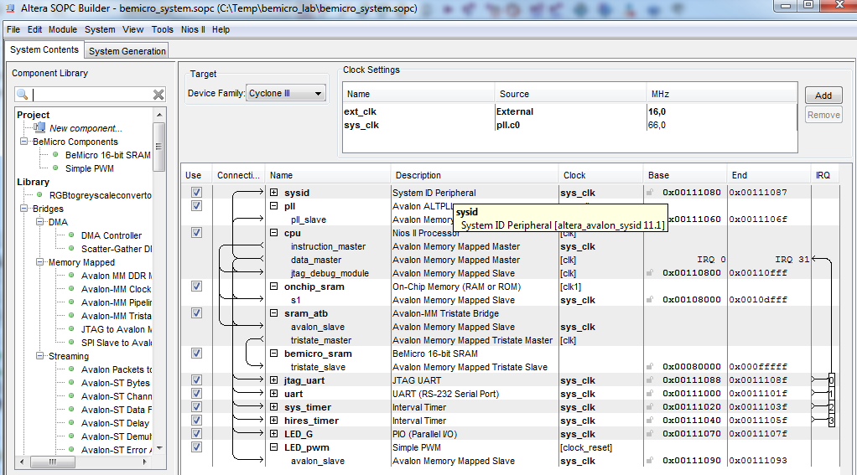

Slide 14
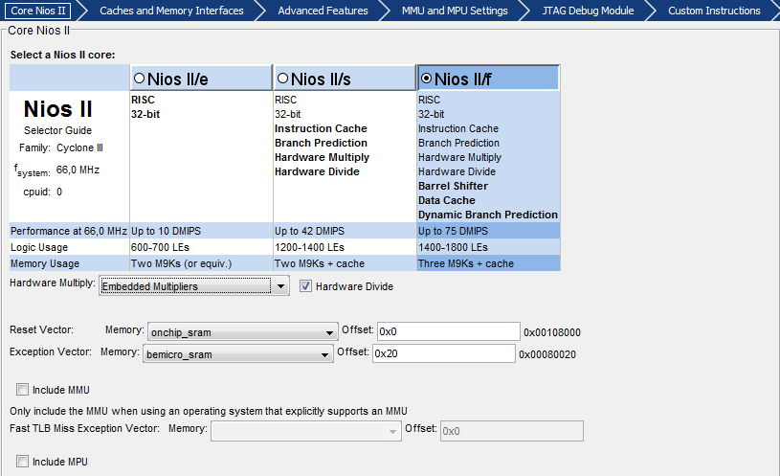

Slide 15
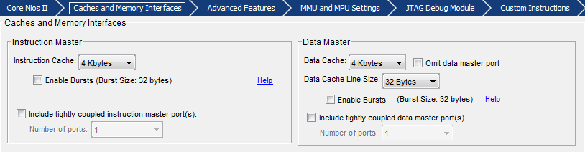

Slide 16
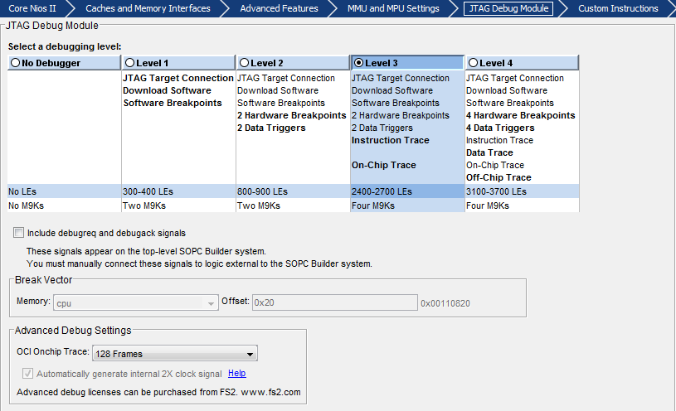

Slide 17
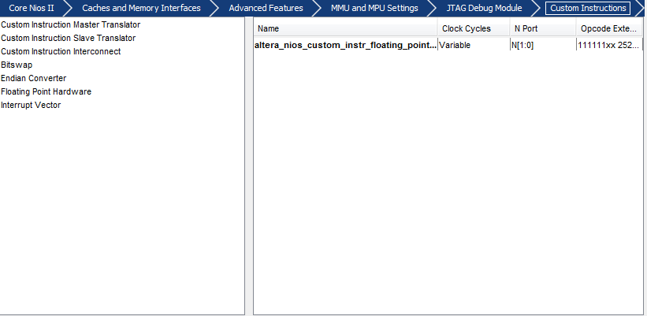

Slide 18
